Slide 1
Differentiating Malicious and Benign Mobile App Behaviors
Gao Xiang
Oct, 20, 2016

Slide 2
AppIntent: Analyzing Sensitive Data transmission in Android for Privacy Leakage detection(CCS’13)

Slide 3
Background
Observation
Transmission of sensitive data in itself does not indicate privacy leakage
A better indicator may be whether the transmission is by user intention or not.
Almost impossible to determine user intentions automatically
This paper proposed a method to extract the context information for analyst
Notes:
Most approaches of privacy leakage detection on smartphones focus on detecting sensitive data transmission, and check whether personal data leaves the device. However, personal data leaving the device does not indicate privacy leakage. In our situation, the message sent by an app can be a data leak, or just a normal use.
The other observation is that whether the transmission is by user intention or not can be a better indicator for privacy leakage. For example, when using SMS apps, a user can forward an SMS message to a third party, by several button clicking on the touchscreen.
Unfortunately, due to the complex nature of user intention and different/unpredictable settings of different apps, it is almost impossible to have an automated method to determine user intentions.
This paper proposed a method to extract the context information in which the data transmission occurs. Intuitively presented context information will make the task of the human analyst easier in determining if the transmission is user intended.

Slide 4
Overview
Bytecode
Event Constraint Graph
Symbolic execution
Static analysis
Sensitive data transmission path
Event Input
Data Input
Dynamic analysis
Analyst
Notes:
Concentrate on bytecode;
Static analysis to get the sensitive data transition path;
Extract the event constraint graph, all the event in this graph may trigger at least one instruction in the data transition path;
Symbolic execution in the constraint graph, get the event input and data constraint;
Those information precisely tell under what conditions transmission would happen, but not intuitive enough. Using those input, they adopt a InstrumentaionTestRunner to automate the app execution step by step, which reflect users’ interactions in UI manipulation.
Then, provide this information to analyst to determine whether the data transition is malicious or not.

Slide 5
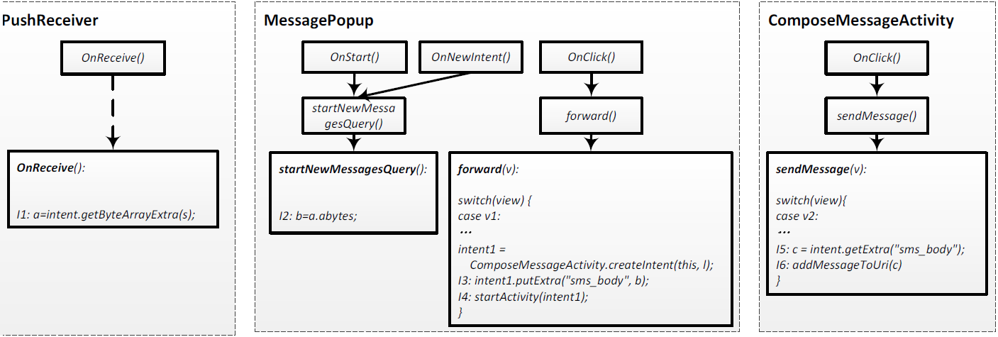
Static analysis
Taint analysis:
Construct the data transmission graph
A simplified SMS forwarding case

Slide 6
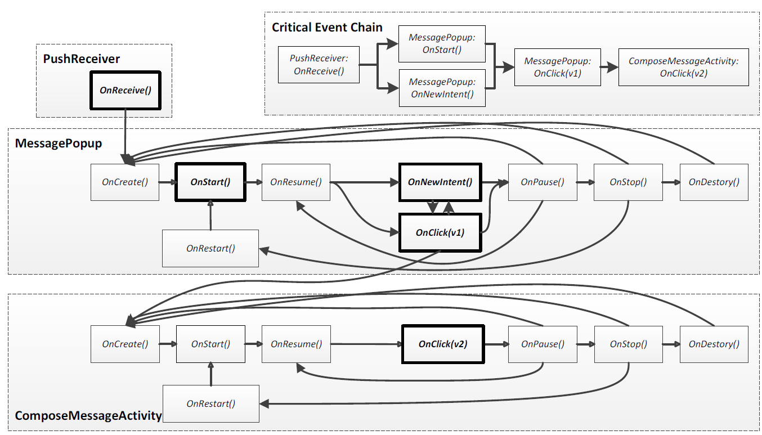
Event-space Constraint Graph
Related Event:
Thick-line node: contains at least one instruction in data propagation path (Critical event)
Thin-line node: the prerequisite for a critical event (Essential event)

Slide 7
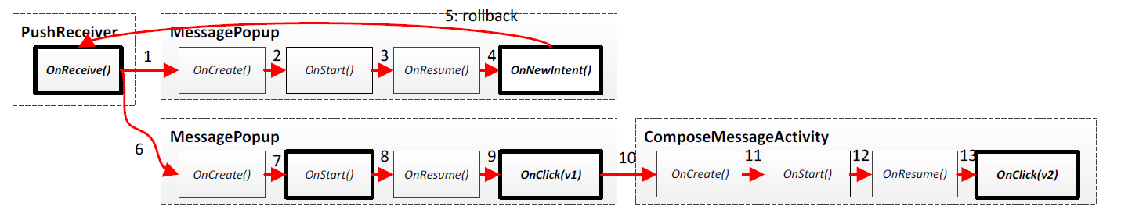
Symbolic execution
Travel all the critical node
Extract event input and data input information

Slide 8
Dynamic Analysis Platform
Event-Space Constraint Graph
Activated views of GUI event
Event Input
Instrumentation
TestRuner
Sensitive data read and transmission
Data Input

Slide 9
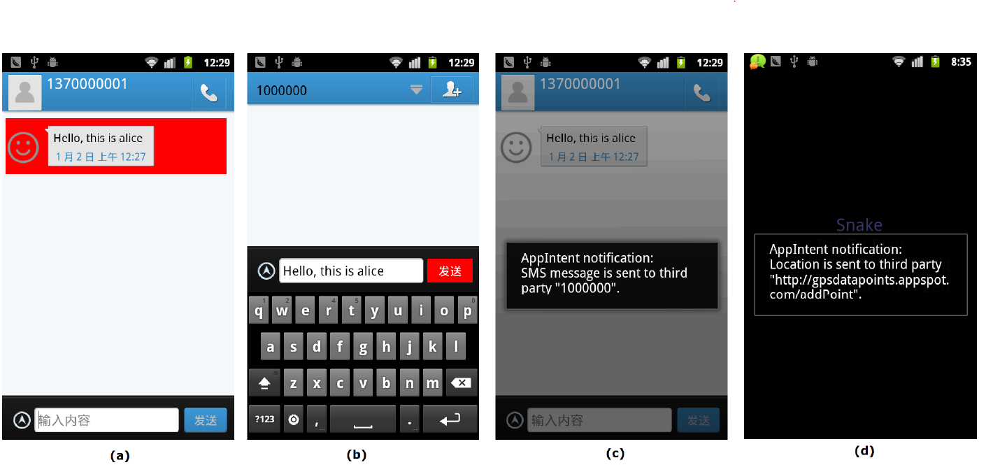
Dynamic Analysis Platform

Slide 10
Limitation
Not all data leakage is relevant to GUI
Need analyst to decide whether the data transmission is malicious or not

Slide 11
AppContext: Differentiating Malicious and Benign Mobile App Behaviors Using Context(ICSE’15)

Slide 12
Introduction
Goal:
Automatically differentiate malicious and benign behaviors within apps
Basic idea:
Extract context information using static analysis
Differentiate behaviors based on context that trigger security-sensitive behavior
Using machine learning method to classify malicious and benign behavior

Slide 13
Overview
Bytecode
Context Information
Flow analysis
Activation Event
Context factor
Extended call graph
Reduced inter-procedure CFG
Machine learning
Call graph contains inter-component communication
The control flow graph from activation event to the method call that trigger security-sensitive behavior

Slide 14
Two Definition
Security-sensitive behavior
Permission-protected method(send message)
Sources or sinks methods
Dynamic loading method
Context definition
Activation events: events that finally trigger the security-sensitive behavior method
Context factors: the conditional values along with the critical path

Slide 15
Identifying Activation Event
Entry point type
Lifecycle methods
Event-handling methods and UI events
Security-sensitive method calls
Analyzer
Set of activation events for each security-sensitive calls
Entry point
Lifecycle method
Event handling
OnRecieve
OnClick

Slide 16
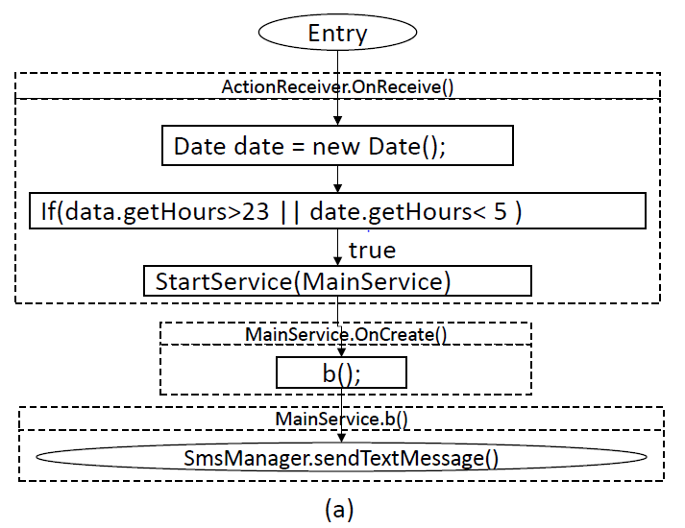
Extracting Context Factors
Context factor:
Data.getHours
Reduced inter-procedure CFG
Notes:
Reduced inter-procedure control flow graph neglects the irrelevant code blocks and just shows the control flow from entry point to security-sensitive method.

Slide 17
Classify security-sensitive behavior
Machine learning(SVM)
Features provided to Machine learning
Permission
Activation Event
Context Factors

Slide 18
Limitation
Just focus on control flow graph
Context factor may not be enough to reflect the behavior
Notes:
When malicious behavior and benign behavior are in the same control flow

Slide 19
Our solution on android SMS repair

Slide 20
Potential framework
Data flow via Files or databases
Reduced Data flow graph
Backward from the parameters of sendTextMessage
Bytecode
Malicious behavior check
Repair
Backward from sendTextMessage
Reduced CFG

Slide 21
Malicious behavior check
Send usage scenarios | Detection
User composes the SMS body and sends it instantly | SMS content and number should be the input of user(DFG)
User composes the SMS body and Schedules the time to send | SMS content and number should be user input. However this data can be stored in database or file
Automatically send user configured SMS as a response to an incoming SMS | SMS content and number should be user input. Meanwhile those data can be stored in database or file
Forward message to a certain number | Should contain user interaction(CFG) numbers should from user input(DFG)

Slide 22
Repair
Scenarios 1
Scenarios 3
Benign
A
B
C
D
Benign & Malicious
A
B
C
Malicious
E
F
Add a conditional statement
Block or popup a dialog
Scenarios 2
Benign
A
B
C
D
Malicious
E
F

